Slide 1
CPCU 540 – Finance and Accounting for Insurance Professionals
Tutoring Sessions
June 16 – July 21, 2014
Hosted by the Central Missouri Chapter of CPCU
at Shelter Insurance Company
and taught by Clint Smith
Notes:
Hello and welcome to the first of six free tutoring sessions for CPCU 540 (Finance and Accounting for Insurance Professionals) held here at Shelter Insurance Company, hosted by the Central Missouri Chapter of CPCU, and taught by me, Clint Smith.

Slide 2
Clint Smith
CPCU designee since 2012
Central MO CPCU 2012 Excellence Award Winner
Served on Website and I-Day Committees
Reinsurance Underwriter for Shelter Re from 2007 – 2012
Associate in Reinsurance (ARe) designee since 2009
Bachelors of Science degree in Personal Financial Planning from the University of Missouri – Columbia
Notes:
Just to let you know a little about me, my name is Clint Smith. I am a graduate from the University of Missouri-Columbia with a BS in Personal Financial Planning. After graduating I worked at Shelter Insurance for six years with the last five spent as a Reinsurance Underwriter with Shelter Re. During my time at Shelter I completed the AINS, Are, and finally my CPCU designation in 2012. Before I officially earned my designation I began teaching the CPCU 540 classes, served on the Website Committee to post and edit information about this course and other goings-on with the Central MO CPCU Chapter, and on the I-Day Committee where I helped develop the theme, create the copy for the I-Day Booklet, and create and run the I-Day AV media (presenter slides, etc).
As part of the introduction, how many students have completed at least one other CPCU Course? For how many people is this the last CPCU course? What other designations have students have attained? Further, get to know what departments they work in and for which companies.

Slide 3
CPCU 540 Tutoring Session Schedule
Session 1 – Introduction, overview of basic CPCU 540 calculations and using the Financial Calculator
Session 2 – Chapters 1, 2, & 3
Session 3 – Chapters 4, 5, & 6
Session 4 – Chapters 7, 8, & 9
Session 5 – Chapter 10, 11, & 12
Session 6 – Final Review
Notes:
Today is, of course, our first session and it will cover an overview of the important CPCU 540 calculations using both the formulas and the financial calculator.
Following today’s session we will have five more sessions. The next four sessions will cover three chapters each and the final session will be a final review to answer any lingering questions you may have and will be based both upon what I note students struggle with most during our sessions and your feedback.
I would ask that as we go through each of these lessons you keep track of what is giving you the greatest difficult. If there are any topics you are struggling with you can obviously ask me during class, but I also hope you save these and let me know via email so I can build the Final Review session material ahead of time.

Slide 4
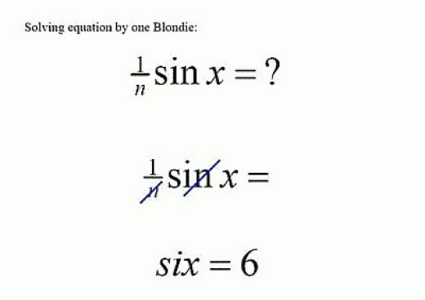
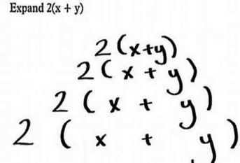
Introduction to CPCU 540 Financial Calculations and using the Financial Calculator
Session 1 – March 1, 2011
Notes:
I wanted to start out this first session going over some of the bigger math problems that you will encounter in this course and go over how you enter those into the calculator to help ensure that we are all on the page. I know that for many people math can be a confounding topic - you may know how to do the functions in your day-to-day work, but when it comes to testing things just go haywire and your brain shorts out. While the vocabulary and concepts are a big part of the test, I want to make sure that you fully understand how the formulas are calculated so you can at least ace this portion and don’t end up with answers like those above.

Slide 5
Introduction to CPCU 540 Financial Calculations and using the Financial Calculator
Order of Operations
PPMDAS (Pretty Please My Dear Aunt Sally)
Parenthesis ( )
Powers ^ or 1^{n}
Multiplication x
Division ÷ or /
Addition +
Subtraction –
Example: ( 2 + 4 ) ² x 2 ÷ √ 25 – 16 =
6 ² x 2 ÷ √ 9 =
36 x 2 ÷ 3 =
72 ÷ 3 =
24
Reminder: Roots are powers (example – square root = ^ ½), but also treated as parenthesis (operations must be done inside before applying the root).
Yes: √25 – 16 = (25 – 16)^{1/2} = √9 = 3
No: √25 – 16 = √25 - √16 = 5 – 4 = 1
Notes:
We will start with the basic Order of Operations. While we are all likely familiar with these symbols, I want to make sure everyone knows how they are used when combined into a single formula as some of the Future Value and Present Value formulas will use these extensively.
While there are many out there, one of the most common mnemonic devices for Order of Operations is “Pretty Please My Dear Aunt Sally”, which stands for: Parenthesis, Powers, Multiplication, Division, Addition, and Subtraction.
As noted in the example at the bottom, please remember that Roots (square root, cubed root, etc) are treated as Powers as they are technically represented as x^{½} .
To the right is an example of a formula that includes all of the operations.

Slide 6
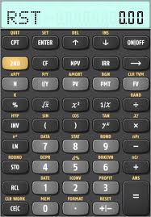
Introduction to CPCU 540 Financial Calculations and using the Financial Calculator
Texas Instruments BA-II Plus Financial Calculator
Important Buttons
Standard Keys
Number keys and decimal point
( ) x^{y} x ÷ + – = and + I – (positive/negative)
Important Time Value of Money (TVM) Keys
N = Number of Years
I/Y = Interest Rate per Year
PV = Present Value
PMT = PMT per Period
FV = Future Value
2ND = Do the function in Yellow above key
P/Y = Number of Payments per Year
BGN = Beginning (for annuity due)
CF = Cash Flow
NPV = Net Present Value
IRR = Internal Rate of Return
RESET = for resetting calculator in between
calculations to clear entries
Note: remember the difference between ENTER and Equals (=)
Notes:
Another important aid for making our calculations is the Financial Calculator. Shown here is the Texas BA-II Plus that I will be using to teach this class. Included are the standard numeral and arithmetic keys, but also on this calculator are important financial calculation keys including those shown in the lower right.

Slide 7
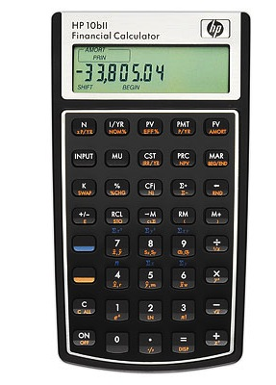
Introduction to CPCU 540 Financial Calculations and using the Financial Calculator
HP 10bII Financial Calculator
Important Buttons
Standard Keys
Number keys and decimal point
( ) x^{y} x ÷ + – = and + I – (positive/negative)
Important Time Value of Money (TVM) Keys
N = Number of Years
I/YR = Interest Rate per Year
PV = Present Value
PMT = PMT per Period
FV = Future Value
Orange = Do the function in Orange below key
P/YR = Number of Payments per Year
END = Payment at End of Year (Ordinary Annuity)
BGN = Payment at Beginning of Year (Annuity Due)
CF = Cash Flow
NPV = Net Present Value
EFF % = Effective Rate of Return
C ALL = for resetting calculator in between
calculations to clear entries
Notes:
Shown here is the HP 10bII that many others use. Where the Texas Instruments calculator uses a 2nd button to access the other functions associated with each key, this calculator uses Orange and Blue buttons. However, only the Orange will be used for our purposes. All of the other buttons are similar to the Texas Instruments calculator, but may have slightly different abbreviations (P/Y compared to P/YR).

Slide 8
Introduction to CPCU 540 Financial Calculations and using the Financial Calculator
Standard Accounting Equation: Assets = Liabilities + Owners’ Equity
Insurance Accounting Equation: Assets = Liabilities + Policyholders’ Surplus
also restated as: Policyholders’ Surplus = Assets – Liabilities
Shelter Re 2010 Example:
Policyholders’ Surplus = $270M – $99M
Policyholders’ Surplus = $171M
Notes:
The most basic equation of a company’s balance sheet is that shown above, the Standard Accounting Equation where Assets are equal to Liabilities plus Owners’ Equity. In insurance, Owners’ Equity is referred to as Policyholders’ Surplus, so we simply exchange the two terms.
If we want to determine what a company’s Policyholders’ Surplus we restate the formula as shown. The example below is a real example from Shelter Reinsurance Company’s 2010 Balance Sheet.

Slide 9
Introduction to CPCU 540 Financial Calculations and using the Financial Calculator
Written Premium – the amount of premium written for a policy period.
Earned Premium – the portion of written premium that has been earned based on the amount of coverage provided for the time that has passed.
Earned Premium = Written Premium x # of days into policy period
# of days in policy period
Example: Earned Premium = $1,200 x ( 6 months ÷ 12 months )
= $1,200 x 1 / 2
= $600
Unearned Premium – the amount of premium for a policy period that has not been earned (the remainder after Earned Premium has been subtracted from Written Premium.
Unearned Premium = Written Premium – Earned Premium
Notes:
Another important calculation is that of Written Premium and Earned Premium. Shown above is the definition of each, with the formula for Earned Premium shown below that with an example to help illustrate how it works in real life.

Slide 10
Introduction to CPCU 540 Financial Calculations and using the Financial Calculator
Loss Ratio, Expense Ratio, & Combined Ratio
Loss Ratio = ( Incurred Loss + LAE ) ÷ Earned Premiums
Incurred Losses include Paid Losses and Outstanding Losses
Earned Premiums are used because Losses are only paid if coverage is
provided, meaning that the premium has been earned.
Used to express what percentage of premium went toward losses.
Expense Ratio = Underwriting Expenses ÷ Written Premiums
Underwriting expenses include all costs of underwriting the business
Written Premium is used because this measures the cost of underwriting the
business, before any premium has been earned.
Used to express what percentage of business went towards underwriting.
Combined Ratio = Expense Ratio + Loss Ratio
Combines the two formulas to determine if the company made an
underwriting profit by combining underwriting expense and losses. Anything below 100% indicates an underwriting profit.
Operating Ratio = Combined Ratio – Investment Income Ratio
Measures overall pre-tax profit from underwriting activities and investments.
Because positive investment return improves the overall results it is
subtracted from the Combined Ratio.
Investment Income Ratio = Investment Income ÷ Earned Premium
Notes:
Another of the most basic calculations are Loss Ratio, Expense Ratio, and Combined Ratio. Formulas and thinking behind each are shown above.

Slide 11
Introduction to CPCU 540 Financial Calculations and using the Financial Calculator
Future and Present Value Calculations by Hand
Future Value = how much a given amount of money today will be worth in the future.
Annual Compounding
FV = PV x ( 1 + r ) ^{n}
FV = Future Value
PV = Present Value
r = Interest Rate
n = Number of Years
Multiple Compounding
FV = PV x ( 1 + r ÷ m) ^{n x m}
FV = Future Value
PV = Present Value
r = Interest Rate
n = Number of Years
m = number of times per year
interest is paid.
Using Table
FV = PV_{n} x FVfactor
Present Value = how much a given amount of money in the future is worth today.
FV = PV x ( 1 + r ) ^{n}
FV ÷ ( 1 + r ) ^{n} = PV
PV = FV ÷ ( 1 + r ) ^{n}
Annual Compounding
PV = FV ÷ ( 1 + r ) ^{n}
Multiple Compounding
PV = FV ÷ ( 1 + r ÷ m) ^{n x m}
Using Table
PV = FV_{n} x PVfactor
Notes:
One of the calculations that tend to confuse people the most are the Future Value and Present Value formulas.
Put simply, a Future Value formula calculates the value of a certain amount today will be worth in the future. To calculate this we must know three things: the amount invested, the interest rate, and the length of time it will be invested.
Further, if the interest compounds more than one time per year (semi-annually, quarterly, monthly, etc) we must factor that into our calculations, as shown in the Multiple Compounding formula. Here we divide the interest rate by the number of times each year it compounds and multiply the number of years by the same number.
The last means of calculating the Future Value is by using the Present Value and multiplying it by the FVfactor which is found at the intersection of the interest rate and the number of years on the FV table, shown on the next slide.
Now that we know the Future Value formula, how do we get to the Present Value? Looking at the formula for Future Value, we can see that Present Value (PV) can be found if we move the pieces around to get it singled out on the left side of the equals sign. We start by dividing both sides by (1 + r) ^{n} so that it cancels out from the PV side and moves over to the FV side. Simply switching things around to put PV on the left side of the equals sign gives us our new formula for PV = FV ÷ (1 +r) ^{n}.
We can then use this for the Multiple Compounding formula inserting the “m” as we did in the FV formula.
The Table formula for PV is exactly as FV table formula, but switching the F to P.

Slide 12
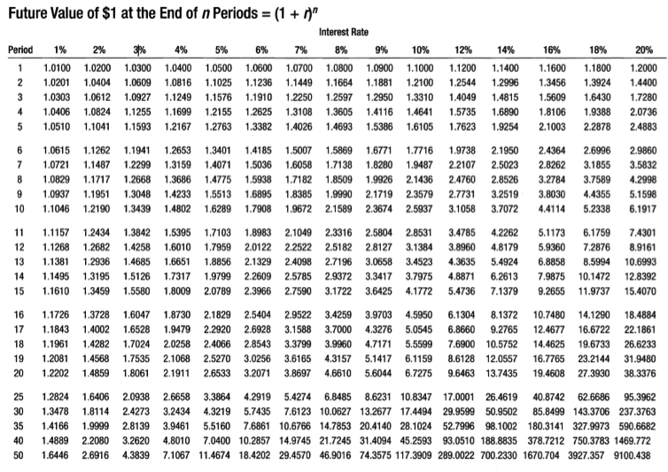
Introduction to CPCU 540 Financial Calculations and using the Financial Calculator
Future and Present Value Calculations by Hand
Using the Future Value Table and FVfactor
Notes:
Here is a view of the Future Value Table which you can also use to get an approximation of the Future Value of an amount, given the Period (“n” – shown on the left column of the table) and the Interest Rate (“r” – shown along the top row of the table). Once you know these two values you simply look for the place where the two values intersect.
We will look at an example of this after the next few slides that cover how to solve the problem using your calculator to highlight the slight difference in answers calculated.

Slide 13
Introduction to CPCU 540 Financial Calculations and using the Financial Calculator
Future Value Calculations
Future Value = how much a given amount of money today will be worth in the future.
Example – If I give you $100 today and you put that money into an account earning 5%, how much is it worth in one year, assuming annual compounding?
PV = 100
r = .05
n = 1
FV = ?
FV = PV x (1 + r) ^{n}
FV = 100 x (1 + .05) ¹
FV = 100 x (1.05) ¹
FV = 100 x 1.05
FV = 105
What if invested for five years?
PV = 100 x (1 + .05) ⁵
PV = 127.63
Example – If I give you $100 today and you put that money into an account earning 5%, how much is it worth in five years, assuming monthly compounding?
PV = 100
r = .05
n = 5
m = 12
FV = ?
FV = PV x (1 + r ÷ m) ^{n x m}
FV = 100 x (1 + .05 ÷ 12) ^{5 x 12}
FV = 100 x (1 + .0041667) ⁶⁰
FV = 100 x (1.0041667) ⁶⁰
FV = 100 x 1.2833
FV = 128.33
Notes:
This slide provides some examples of Future Value formulas and how they are entered into the calculator. First is a simple example where you invest $100 for one year in an account earning 5%.
Moving down you can see how much the Future Value increases when the money is invested for five years. That is because the first year the interest is earned on the Present $100, but the second year it is calculated on the $105, and so on.
Taken a step further, you can see the effect that multiple compounding has on the ultimate value. While it may seem like a small increase, the impact on larger sums invested over longer periods can be dramatic.

Slide 14
Introduction to CPCU 540 Financial Calculations and using the Financial Calculator
FV (Annual Compounding) using TI BAII Plus
Example – If I give you $100 today and you put that money into an account earning 5%, how much is it worth in one year assuming annual compounding?
PV = -100
I/Y = 5%
N = 1
P/Y = 1
CPT = FV
Step 1: Reset the calculator
2nd, +/- (Reset), Enter, 2nd, CPT (Quit)
Step 2: Set P/Y to 1
2nd, I/Y (P/Y), 1, Enter, 2nd, CPT (Quit)
Step 3: Enter your TVM Variables
100, +/-, PV
5, I/Y
1, N
CPT, FV
FV = 105.00
Notes:
Now let’s look at how we enter our previous question about Annual Compounding into the Texas Instruments BAII Plus Financial Calculator. Here’s a look at our calculator and let’s bring that problem back up along with our variables.
The first step we want to perform each time we are going to use the calculator is to Reset. This will clear out any unwanted variables that may have been left from a previous calculation. To do this we hit 2nd, then the +/- button which will ask us if we want to Reset the calculator. To say “yes” we hit the ENTER button, and then hit 2nd and CPT to QUIT and get back to our home screen.
Since we are using Annual Compounding we want to make sure our calculator is set to one payment per year. To do this we hit 2nd, then I/Y to access the P/Y screen. To set our P/Y you press 1, then hit ENTER to set the P/Y to 1. To get back to the home screen again we hit 2nd and CPT to QUIT.
Now we are ready to enter the Time Value of Money variables we noted above. To start, type in 100 and hit the +/- button to make the PV a negative number, and then hit PV. Note, we enter the PV as a negative because this tells the calculator the money is going away from us to be invested; when the money comes back to us after the five years of being invested, it is then a positive. Then hit 5 and I/Y to set our interest rate. Then 1 and N to set our Number of Payments. Finally, hit CPT and FV to compute our Future Value, which in this case is 105.00.

Slide 15
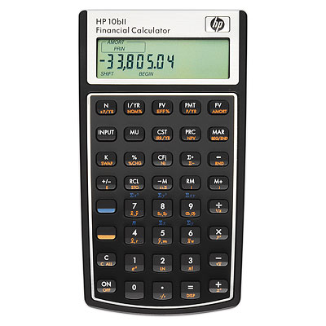
Introduction to CPCU 540 Financial Calculations and using the Financial Calculator
FV (Annual Compounding) using the HP 10bII
Example – If I give you $100 today and you put that money into an account earning 5%, how much is it worth in one year assuming annual compounding?
PV = -100
I/YR = 5%
N = 1
P/YR = 1
CPT = FV
Step 1: Reset the calculator
Orange, C (C All), C
Step 2: Set P/Y to 1
1, Orange, PMT (P/YR), C
Step 3: Enter your TVM Variables
100, Orange, Decimal Point . (+/-), PV
5, I/YR
1, N
FV
FV = 105.00
Notes:
For those of you who have the HP 10bII, let’s look at how we enter the same problem. Here’s a look at our calculator and let’s bring that problem back up along with our variables.
The first step we want to perform each time we are going to use the calculator is to Reset. This will clear out any unwanted variables that may have been left from a previous calculation. To do this we hit Orange, then the C button which will Clear All (reset) the calculator. Hit C again to get back to our home screen.
Since we are using Annual Compounding we want to make sure our calculator is set to one payment per year. To do this we hit 1, then Orange button and PMT set out P/YR to 1. Hitting C again takes us back to the home screen.
Now we are ready to enter the Time Value of Money variables we noted above. To start, type in 100, hit Orange button, and then the decimal point “.” button to access the +/- and make the PV a negative number, and then hit PV. Then hit 5 and I/Y to set our interest rate. Then 1 and N to set our Number of Payments. Finally, hit FV to compute our Future Value, which in this case is 105.00.

Slide 16
Introduction to CPCU 540 Financial Calculations and using the Financial Calculator
Future and Present Value Calculations by Hand
Using the Future Value Table and FVfactor
Notes:
Let’s bring back the Future Value table to look at how we answer this question. In our first example we invested $100 for 1 year (n = 1) at a 5% interest rate (r = 5%). If we look in the Period column for “1”, then scan over to the column under “5%” we can see it gives us a factor of 1.0500. This is then multiplied by the $100 we invested ($100 x 1.0500) to give us an answer of $105.00. Easy, right?!
Now let’s take it a little further with our second example, where we extended the period to 5 years (n = 5). Again, we scroll down the Period column until we get to “5”, then scan over to the “5%” column under Interest Rate, and we get a Fvfactor of 1.2763. If we multiply this by the $100 we invested ($100 x 1.2763) we get an answer of $127.63. Again, this exactly matches the answer we got using the formulas and the calculator.

Slide 17
Introduction to CPCU 540 Financial Calculations and using the Financial Calculator
Present Value Calculations
Present Value = how much a given amount of money in the future is worth today.
Example – If I gave you $100 in one year how much is it worth today, assuming 5% interest per year with annual compounding?
FV = 100
r = .05
n = 1
PV = ?
PV = FV ÷ (1 + r) ^{n}
PV = 100 ÷ (1 + .05) ¹
PV = 100 ÷ (1.05) ¹
PV = 100 ÷ 1.05
PV = 95.24
What if it is given to you in five years?
PV = 100 ÷ (1 + .05) ⁵
PV = 78.35
Example – If I give you $100 in five years how much is it worth today, assuming 5% interest per year with monthly compounding?
FV = 100
r = .05
n = 5
m = 12
PV = ?
PV = FV ÷ (1 + r ÷ m) ^{n x m}
PV = 100 ÷ (1 + .05 ÷ 12) ^{5 x 12}
PV = 100 ÷ (1 + .0041667) ⁶⁰
PV = 100 ÷ (1.0041667) ⁶⁰
PV = 100 ÷ 1.2833
PV = 77.92
Notes:
This slide shows some examples of Present Value formulas and how they are identified in the calculator. The end result is $95.24. In real world terms, this tells us that you would have to invest $95.24 today to get $100 back at the end of the year if invested in an account earning 5%.
If you had five years to invest the money, then you need significantly less ($78.35) to have the same $100.
You can see the effect that multiple compounding has on the ultimate value.
One thing I always recommend is that students read the problem, outline what information they know and then determine what they are looking for. This helps you keep outlined what your variables are and what you don’t know so that you can solve for it.

Slide 18
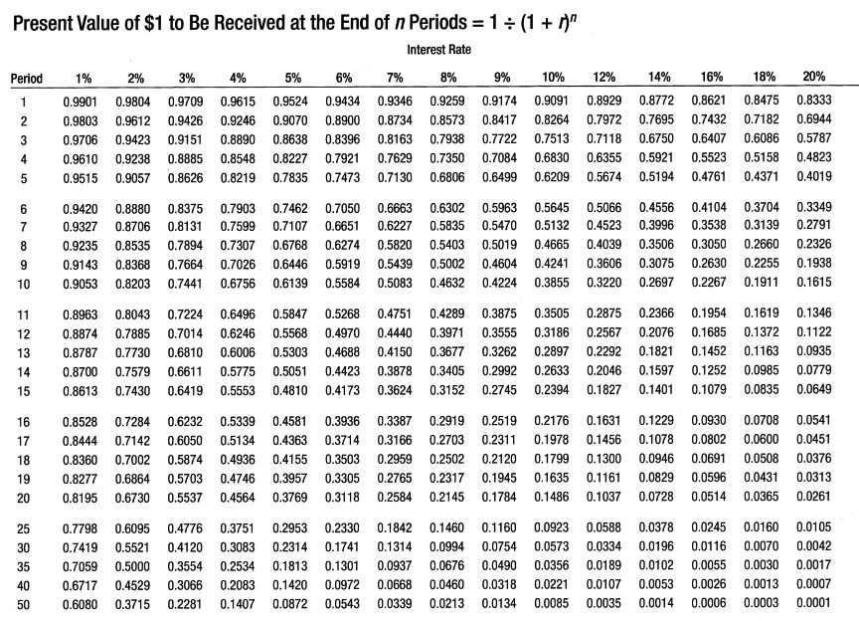
Introduction to CPCU 540 Financial Calculations and using the Financial Calculator
Future and Present Value Calculations by Hand
Using the Present Value Table and PVfactor
Notes:
Like we did with the Future Value table, now let’s look at the Present Value table to calculate the answers.
In our first example we expected a Future Value of $100 and wanted to know what the Present Value would be if it was invested for one year (n = 1) at 5% interest (r = 5%). As we did before, scan down the Period column for “1”, then go right until you reach the 5% interest column. Here we find a value of 0.9524. Multiplying this by our $100 and we get an answer of $95.24 Present Value, matching what we calculated with the formula.

Slide 19
Introduction to CPCU 540 Financial Calculations and using the Financial Calculator
PV (Monthly Compounding) using the TI BAII Plus
Example – If I give you $100 five years from now, how much is it worth today, assuming 5% interest per year and monthly compounding?
FV = 100
I/Y = 5%
N = 5
P/Y = 12
PV = ?
Step 1: Reset the calculator
2nd, +/- (Reset), Enter, 2nd, CPT (Quit)
Step 2: Set P/Y to 12
2nd, I/Y (P/Y), 12, Enter, 2nd, CPT (Quit)
Step 3: Enter your TVM Variables
100, FV
5, I/Y
5, 2nd, N (xP/Y), N
CPT, PV
PV = -77.92
Notes:
Now let’s look at how we enter our previous question about Monthly Compounding into the Texas Instruments BAII Plus Financial Calculator. Again we will look at our calculator and bring the problem back up along with our variables.
To start, you want to Reset the calculator, clearing out any unwanted variables that may have been left from a previous calculation. To do this we hit 2nd, then the +/- button which will ask us if we want to Reset the calculator. To say yes we hit the ENTER button, and then hit 2nd and CPT to QUIT and get back to our home screen.
Since we are using Monthly Compounding we want to make sure our calculator is set to twelve payments per year (assuming your calculator doesn’t automatically reset to this). To do this we hit 2nd, then I/Y to access the P/Y screen. If your P/Y is already set to 12, simply hit 2nd and CPT to Quit. If you need to set the P/Y you press 12 and hit ENTER. To get back to the home screen again we hit 2nd and CPT to QUIT.
Now we are ready to enter the Time Value of Money variables we noted above. To start, type in 100 and hit FV. Note, here we enter the FV as a positive because the money comes back to us in the Future, but goes away from us in the Present, being a negative transaction. Then hit 5 and I/Y to set our interest rate (the calculator automatically divides the I/Y by 12 like we did in our formulas). Next, you enter 5 and hit 2nd followed by N to use the xP/Y function, which will multiply our five years by the number of payments per year we set earlier (12). To set this as our N you must hit N again. Finally, hit CPT and PV to compute our Present Value, which in this case is -77.92.

Slide 20
Introduction to CPCU 540 Financial Calculations and using the Financial Calculator
PV (Monthly Compounding) using the HP 10bII
Example – If I give you $100 five years from now, how much is it worth today, assuming 5% interest per year and monthly compounding?
FV = 100
I/YR = 5%
N = 5
P/YR = 12
PV = ?
Step 1: Reset the calculator
Orange, C (C All), C
Step 2: Set P/Y to 12
12, Orange, PMT (P/YR), C
Step 3: Enter your TVM Variables
100, FV
5, I/YR
5, Orange, N (xP/YR), N
PV
PV = -77.92
Notes:
For those of you who have the HP 10bII, let’s look at how we enter the same problem. Here’s a look at our calculator and let’s bring that problem back up along with our variables.
The first step we want to perform each time we are going to use the calculator is to Reset. This will clear out any unwanted variables that may have been left from a previous calculation. To do this we hit Orange, then the C button which will Clear All (reset) the calculator. Hit C again to get back to our home screen.
Since we are using Monthly Compounding we want to make sure our calculator is set to twelve payments per year. To do this we hit 12, then Orange button and PMT set out P/YR to 12. Hitting C again takes us back to the home screen.
Now we are ready to enter the Time Value of Money variables we noted above. To start, type in 100 and hit FV. Then hit 5 and I/Y to set our interest rate. Then 5, the Orange button and N to multiply our five years by the number of payments per year we set earlier (12). Like the TI BAII Plus, you must hit N again to set this value. Finally, hit PV to compute our Present Value, which in this case is -77.92.

Slide 21
Chapter 6 – Cash Flow Valuation
Effective Annual Interest Rate
Effective Annual Interest Rate: interest is stated at its annual rate, but if the interest is compounded more frequently the effective interest rate is higher than the stated rate.
Example: What is the Future Value of $500 at the end of one year with a 5% interest rate compounding annually? Semi-annually? Quarterly? Monthly? Weekly?
Annually
FV = 500 x (1 + .05 ÷ 1) ^{1 x 1}
= 525.00
Semi-Annual
FV = 500 x (1 + .05 ÷ 2) ^{1 x 2}
= 525.32
Quarterly
FV = 500 x (1 + .05 ÷ 4) ^{1 x 4}
= 525.48
Monthly
FV = 500 x (1 + .05 ÷ 12) ^{1 x 12}
= 525.58
Weekly
FV = 500 x (1 + .05 ÷ 52) ^{1 x 52}
= 525.63
EAR = (1 + .05 ÷ 1) ¹
= 1.05000
= (1.05000 – 1) x 100
= 5.000%
EAR = (1 + .05 ÷ 2) ²
= 1.05063
= (1.05063 – 1) x 100
= 5.063%
EAR = (1 + .05 ÷ 4) ⁴
= 1.05095
= (1.05095 – 1) x 100
= 5.095%
EAR = (1 + .05 ÷ 12) ¹²
= 1.05116
= (1.05116 – 1) x 100
= 5.116%
EAR = (1 + .05 ÷ 52) ⁵²
= 1.05125
= (1.05125 – 1) x 100
= 5.125%
Notes:
As we look at the results of our formula with the different compounding amounts, we can see that the value of our money slowly increases as we increase the number of compounds per year. This is because of the Effective Annual Rate (EAR).
Looking at each of our formulas, 500 stays the same each time, but we get a different result. The part changing is the section after the PV that includes the interest rate and number of years, referred to as the EAR. By removing the 500 from the formula and only calculating the part to the right, we can calculate our EAR. You can see that each of our results includes a leading 1, but we want to see this as an interest rate. To do this, you take your result and subtract one, then multiply by 100. This gives us the percentages we are looking for.

Slide 22
Introduction to CPCU 540 Financial Calculations and using the Financial Calculator
Determining other FV & PV Variables
Using Financial Calculator – enter values you know (must have at least 4 of the 5), then hit CPT and the value you want to know.
But what if we want to find r or n using our formulas? Things here get a little complicated.
FV = 1,000
PV = -100
I/Y = 10%
P/Y = 1
N = ?
FV = 1,000
N = 24.16
I/Y = 10%
P/Y = 1
PV = ?
FV = PV x (1 + r) ^{n}
FV ÷ PV = (1 + r) ^{n}
( FV ÷ PV ) ^{1 / n} = 1 + r
( FV ÷ PV ) ^{1 / n} – 1 = r
N = 24.16
PV = -99.99
r = ( FV ÷ PV ) ^{1 / n} – 1
n = ln ( FV ÷ PV) ÷ ln (1 + r)
FV = 1,000
PV = -100
N = 24.16
P/Y = 1
I/Y = ?
PV = -100
N = 24.16
I/Y = 10%
P/Y = 1
FV = ?
ln = natural log
I/Y = 10%
FV = 1,000
Notes:
This slide outlines how you find other variables in the FV or PV formula using the calculator and using the formula to solve for the “r” and the “n”. To solve Time Value of Money problems using your calculator you need to know all the variables except the one you are looking for.
You can see here in our first example our Future Value is 1,000, the Present Value is -100 (and must be set as a negative so your calculator doesn’t return an error), our Interest Rate is 10%, and we are looking for our N. Assume the compounding is annual if the question doesn’t mention anything different. So we enter these values into our calculator and your N will be 24.16 years.
You can try this a number of different ways by using this N and removing the value you are looking for which you will ultimately compute. You can see that for each value you compute it returns the value we input in the original formula.
To find our r or n values using the formula is a little more complex, so the calculator is recommended.
Let’s start with the FV formula where FV = PV x (1 + r) ^{n} and divide both sides by PV so our formula is now FV ÷ PV = (1 + r) ^{n}. To get rid of our power we multiply the left side of the equation to the 1/n power so our equation is now (FV ÷ PV) ^{1 / n} = 1 + r. Now to get the r alone we subtract 1 and now r = ( FV ÷ PV ) ^{1 / n} – 1. Like I said, not the easiest formula to use, but it can be done.
Finding “n” is even more awkward as we bring in the natural log button. Without going into how it is done, our ultimate formula is n = ln (FV ÷ PV) ÷ ln (1 + r).

Slide 23
Introduction to CPCU 540 Financial Calculations and using the Financial Calculator
Future Value of an Ordinary Annuity
Future Value of an Ordinary Annuity = how much a given series of payments paid at the end of the year will be worth in the future?
FV = PV x (1 + r) ⁰ + PV x (1 + r) ¹ + PV x (1 + r) ² + … + PV x (1 + r) ^{n - 1}
Example: What is the Future Value of $500 payments at the end of each year for five years, earning 5% interest per year with annual compounding?
First payment (end of year)
FV = 500 x (1 + .05) ⁰
= 500.00
Payment at end of 2nd year
FV = 500 x (1 + .05) ¹
= 525.00
Payment at end of 3rd year
FV = 500 x (1 + .05) ²
= 551.25
Payment at end of 4th year
FV = 500 x (1 + .05) ³
= 578.81
Payment at end of 5th year
FV = 500 x (1 + .05) ⁴
= 607.75
= 2,762.81
Note: Your calculator is automatically set to make payments at the end of the year (END)
PMT = 500
PMT @ END
N = 5
I/Y = 5%
m = 1
FV = ?
Using Table
FVA = A x FVAF
FVAF is the intersection on the table between the Period in Years “n” and the Interest Rate “r”
FV = 2,762.82
Notes:
Taking Future Value and Time Value of Money one step further, here we look at the Future Value of an Annuity, which is a series of payments over time with payments made either at the end of the period (Ordinary Annuity) or beginning of the period (Annuity Due).
In this example we are looking at what the future value of $500 is worth at the end of the first year. Because the money is paid at the end of the year it hasn’t been able to earn any interest over the year and is therefore worth simply the $500. Another way of looking at this is using our FV formula and entering 0 for the n.
The simplest way to think of it is in a real life situation. If someone says they are going to give you $500 one year from now, what is that $500 worth in the future? The answer is simply $500. From here, what is $500 worth a year from that point? Here we apply our factor and get $525. This is repeated until all of the payments have been made.
From this point we are looking at that $500 another year out each time, up to the point where we reach our n, in this case 5, which is then entered into n – 1, or 4. Once we do that we add up all of the Future Values we calculated and get our total of $2,762.81.
To do this on your calculator, again start by resetting, and then make sure your P/Y is set to 1. In this case our PV is replaced by a set payment of $500 (PMT). So we set our PMT at 500, our I/Y at 5%, and our N at 5 (remains at 5 because there is only one payment per year). Note, that for this type of annuity your payments must be set to the END, which is automatically the setting for both calculators.
Once these values are input you calculate your FV, which is very close to our formulated answer at $2,762.82.

Slide 24
Introduction to CPCU 540 Financial Calculations and using the Financial Calculator
Future and Present Value Calculations by Hand
Using the Future Value of Annuity Table and FVfactor
Notes:
The Future Value of an Annuity table works exactly like the Future Value table when calculating the answer for an Ordinary Annuity. In our Future Value of an Ordinary Annuity example we were given a series of $500 payments over 5 years (n = 5) in an account earning 5% (r = 5%). Because it is an Ordinary Annuity you simply scan down the Period column until you reach “5”, then right until you reach the “5%” Interest Rate column, where you find a value of 5.5256. You multiply this by the $500 and you get an answer of $2,762.80. While this does not exactly match our calculated answer of $2,762.81 due to rounding, it is still very close and you would be able to select the right answer on the test with this.

Slide 25
Introduction to CPCU 540 Financial Calculations and using the Financial Calculator
Present Value of an Ordinary Annuity
Present Value of an Ordinary Annuity = how much a series of payments made at the end of the year are worth today, with a given time period and rate of interest.
PV = FV ÷ (1 + r) ¹ + FV ÷ (1 + r) ² + FV ÷ (1 + r) ³ + … + FV ÷ (1 + r) ^{n}
Example: What is the Present Value of $500 payments at the end of each year for five years, earning 5% interest per year with annual compounding?
First payment (end of year)
PV = 500 ÷ (1 + .05) ¹
= 476.19
Payment at end of 2nd year
PV = 500 ÷ (1 + .05) ²
= 453.51
Payment at end of 3rd year
PV = 500 ÷ (1 + .05) ³
= 431.92
Payment at end of 4th year
PV = 500 ÷ (1 + .05) ⁴
= 411.35
Payment at end of 5th year
PV = 500 ÷ (1 + .05) ⁵
= 391.76
= 2,164.73
Note: Your calculator is automatically set to make payments at the end of the year (END)
PMT = 500
PMT @ END
N = 5
I/Y = 5%
m = 1
PV = ?
Using Table
PVA = A x PVAF
PVAF is the intersection on the table
between the Period in Years “n” and the
Interest Rate “r”
PV = -2,164.74
Notes:
In this example we are looking at what the present value of $500 that is paid at the end of the year. Because the money is paid at the end of the year it has earned interest and must be reduced by our interest rate factor. Another way of looking at this is using our PV formula, starting with 1. Essentially, we are looking at how much would have to be deposited today to generate a $500 payment one year from now, two years from now, and so on.
From this point we are looking at that $500 backwards another year out each time, up to the point where we reach our n, in this case 5. Once we do that we add up all of the Future Values we calculated and get our total of $2,164.73.
To do this on your calculator, again start by resetting, and then make sure your P/Y is set to 1. In this case our FV is replaced by a set payment of $500 (PMT). So we set our PMT at 500, our I/Y at 5%, and our N at 5 (remains at 5 because there is only one payment per year). Note, that for this type of annuity your payments must be set to the END, which is automatically the setting for both calculators.
Once these values are input you calculate your PV, which is very close to our formulated answer at $2,164.73.

Slide 26
Introduction to CPCU 540 Financial Calculations and using the Financial Calculator
Future and Present Value Calculations by Hand
Using the Present Value of Annuity Table and PVfactor
Notes:
Like the Future Value of Annuity table, here we have one for the Present Value of an Annuity. Looking at our example, we wanted to know what is the Present Value of a series of $500 payments made over 5 years (n = 5) if the money could be invested in an account earning 5% (r = 5%). As it is an Ordinary Annuity you work your way down the Period column until you reach “5”, then scan right until you reach the “5%” column under the Interest Rate header, where you find the value of 4.3295. If you multiply this by the $500 payment you get $2,164.75. Again, this is very close to the answer we calculated using the formula and calculator, which was $2,164.74.

Slide 27
Introduction to CPCU 540 Financial Calculations and using the Financial Calculator
Future Value of an Annuity Due
Future Value of an Annuity Due = how much a given series of payments will be worth in the future if payments are made at the beginning of the year.
Note: because the first payment is made immediately it can earn interest over the year.
FV = PV x (1 + r) ¹ + PV x (1 + r) ² + PV x (1 + r) ³ + … + PV x (1 + r) ^{n}
Example: What is the Future Value of $500 payments at the beginning of each year for five years, earning 5% interest per year with annual compounding?
Payment at beginning of 1st year
FV = 500 x (1 + .05) ¹
= 525.00
Payment at beginning of 2nd year
FV = 500 x (1 + .05) ²
= 551.25
Payment at beginning of 3rd year
FV = 500 x (1 + .05) ³
= 578.81
Payment at beginning of 4th year
FV = 500 x (1 + .05) ⁴
= 607.75
Payment at beginning of 5th year
FV = 500 x (1 + .05) ⁵
= 638.14
= 2,900.95
PMT = 500
PMT @ BGN
N = 5
I/Y = 5%
m = 1
FV = ?
To set the TI calculator to make payments at the beginning of the year (BGN), you hit 2nd, then PMT (BGN), then 2nd, ENTER (SET). The screen will now show BGN, so you hit 2nd and CPT (QUIT) and enter your Time Value of Money information (PMT, N, I/Y) and CPT FV. For the HP, simply hit Orange and MAR to toggle between BEG and END.
FV = 2,900.96
Notes:
Compared to an Ordinary Annuity, where payments are made at the end of each period, an Annuity Due makes its payment at the beginning of each period. Because of that, interest can be earned on the first payment, resulting in interest for the first year and each year thereafter, resulting in a total that is higher than an Ordinary Annuity.
In this case, a real life example is that someone offers to pay you $500 payments each year for five years, and they will pay you that at the beginning of each year. Since you receive your $500 up front, you can invest it for the year and end the year with $525. For each year thereafter, we are essentially taking that $500 at the beginning of the agreement and investing it for two years, three years, four years, and five years. Totaling these values gets our Future Value of $2,900.95, which is higher than our previous Future Value of $2,762.81 because the payments have had more time to earn interest.
To do this on your calculator, again start by resetting, and then make sure your P/Y is set to 1. In this case our PV is replaced by a set payment of $500 (PMT). Because the payments are made at the beginning of the year, you have to change the way your calculator is set by default, with payments at the end of the year.
Each calculator changes this a different, but similar way. For the Texas Instruments BAII Plus you hit 2nd, then PMT and your screen will display END as it is set by default. To change this you hit 2nd and ENTER (SET) and it will change to BGN. From there you can hit 2nd and CPT (QUIT) and get back to your home screen, where you will see BGN displayed in the upper right hand portion of the screen.
On the HP 10bII calculator the steps are quite a bit easier as you simply hit the Orange button and then hit MAR to toggle back and forth between BEG and END.
From here you enter your TVM values as before, hitting 500 and then PMT, 5 and then N, 5 and then I/YR. Once those are entered you hit FV and get your value of $2,900.96.

Slide 28
Introduction to CPCU 540 Financial Calculations and using the Financial Calculator
Present Value of an Annuity Due
Present Value of an Annuity Due = how much a given payment made at the beginning of the year in the future will be worth today.
Note: Because our first payment is made at the beginning of the year, there is no reduction.
PV = FV ÷ (1 + r) ⁰ + FV ÷ (1 + r) ¹ + FV ÷ (1 + r) ² + … + FV ÷ (1 + r) ^{n - 1}
Example: What is the Present Value of $500 payments at the beginning of each year for five years, earning 5% interest per year with annual compounding?
Payment at beginning of 1st year
PV = 500 ÷ (1 + .05) ⁰
= 500.00
Payment at beginning of 2nd year
PV = 500 ÷ (1 + .05) ¹
= 476.19
Payment at beginning of 3rd year
PV = 500 ÷ (1 + .05) ²
= 453.51
Payment at beginning of 4th year
PV = 500 ÷ (1 + .05) ³
= 431.92
Payment at beginning of 5th year
PV = 500 ÷ (1 + .05) ⁴
= 411.35
= 2,272.97
PMT = 500
PMT @ BGN
N = 5
I/Y = 5%
m = 1
PV = ?
To set the TI calculator to make payments at the beginning of the year (BGN), you hit 2nd, then PMT (BGN), then 2nd, ENTER (SET). The screen will now show BGN, so you hit 2nd and CPT (QUIT) and enter your Time Value of Money information (PMT, N, I/Y) and CPT FV. For the HP, simply hit Orange and MAR to toggle between BEG and END.
PV = -2,272.98
Notes:
Now let’s look at the Present Value of an Annuity Due. Because the payment is made at the beginning of the year, there is no reduction made to the $500 payment. In simple terms, what money would have you deposit today to have $500 today? Simply put, $500. This is expressed in our formula by replacing n with n – 1.
However, for each payment after that, where payments are made at the beginning of the year, you have to reduce that $500 by the amount of time passed because you would have to deposit a reduced amount today because it would have time to grow, until the fifth payment is made at the beginning of the fifth year, meaning it had four years to grow.
In this case, a real life example is that someone offers to pay you $500 payments each year for five years, and they will pay you that at the beginning of each year. If instead of collecting that $500 at the beginning of the year you had the money in hand, how much would you need to have that $500 at the end of each of those years? Totaling these values gets our Present Value of $2,272.97, which was higher than our previous Present Value of $2,164.73, because the money was reduced fewer times.
To do this on your calculator, again start by resetting, and then make sure your P/Y is set to 1. In this case our FV is replaced by a set payment of $500 (PMT). Because the payments are made at the beginning of the year, you have to change the way your calculator is set by default, with payments at the end of the year.
Follow the same steps for each calculator as it was explained in the previous slide. From there you enter your TVM values as before, hitting 500 and then PMT, 5 and then N, 5 and then I/YR. Once those are entered you hit PV and get your result of -$2,272.98.

Slide 29
Introduction to CPCU 540 Financial Calculations and using the Financial Calculator
Other Basic Calculations
Mean = average of values in data set.
Example: 5, 6, 7, 5, 4, 6, 7, 5, 9
Mean = ( 5 + 6 + 7 + 5 + 4 + 6 + 7 + 5 + 9 ) ÷ 9
Mean = 54 ÷ 9
Mean = 6
Median = the middle number in a data set.
Even number of data points
Example: 5, 6, 7, 5, 4, 6, 7, 5, 9
Example: 5, 6, 7, 5, 4, 6, 7, 5, 9, 3
Median = 4, 5, 5, 5, 6, 6, 7, 7, 9
Median = 3, 4, 5, 5, 5, 6, 6, 7, 7, 9
Median = 6
Median = (5 + 6) ÷ 2 = 5.5
Mode = the most common number in a data set.
More than one mode
Example: 5, 6, 7, 5, 4, 6, 7, 5, 9
Example: 5, 6, 7, 5, 4, 6, 7, 5, 9, 6
Mode = 4, 5, 5, 5, 6, 6, 7, 7, 9
Mode = 4, 5, 5, 5, 6, 6, 6, 7, 7, 9
Mode = 5
Mode = 5, 6
Notes:
Some other basic calculations that will come up later are Mean, Median, and Mode. Shown above are examples of each and the calculations to find each.
Mean is simply another word for average, so for our data set you add up the values and divide by the total number of data points. In this case we have a total of 54 for the nine values. Dividing 54 by 9 gives you a Mean of 6.
Median is simply the middle number in a data set. To determine this you arrange your values from smallest to largest and select the data point that falls exactly in the middle. Here we rearrange our nine value data set to 4, 5, 5, 5, 6, 6, 7, 7, 9 making the middle data point 6.
But what if we have an even number of values, like 10? Here we have another set of data points exactly like the first, but now we had an additional value of 3. We again rearrange our set to be 3, 4, 5, 5, 5, 6, 6, 7, 7, 9. In this example we have ten digits, so the middle is somewhere in between 5 and 6. To find that we simply add the two together and divide by two to find the average, which is 5.5.
Mode is quite simply the most common, or repeated, number in a data set. In our original data set we rearrange our values from smallest to largest as 4, 5, 5, 5, 6, 6, 7, 7, 9. Here we can see that we have one 4, three 5s, two 6s, two 7s, and one 9, making 5 the most repeated number and therefore our mode.
But what if we have more than one number that is most repeated? Here we can look at the example to the right of our original set which is 5, 6, 7, 5, 4, 6, 7, 5, 9, 6. Rearranging this from smallest to largest we have 4, 5, 5, 5, 6, 6, 6, 7, 7, 9 with one 4, three 5s, three 6s, two 7s, and one 9. Because 5 and 6 are the most repeated number, the set can either be said to have no mode, or be bi-modial with modes of 5 and 6.

Slide 30
Introduction to CPCU 540 Financial Calculations and using the Financial Calculator
Other Basic Calculations
Variance = the difference of a value from the mean.
(5 – 6) ² = -1 ² = 1
(7 – 6) ² = 1 ² = 1
(3 – 6) ² = -3 ² = 9
(5 – 6) ² = -1 ² = 1
(4 – 6) ² = -2 ² = 4
(6 – 6) ² = 0 ² = 0
(3 – 6) ² = -3 ² = 9
(5 – 6) ² = -1 ² = 1
(9 – 6) ² = 3 ² = 9
Variance = 1+1+9+1+4+0+9+1+9
9
Variance = 3.889
Standard Deviation = indicates how far the average data point is from the mean. Low standard deviation indicates that data points are close to the average and vice versa.
√
Standard = 1+1+9+1+4+0+9+1+9
Deviation 9
Standard Deviation = √ Variance
Standard Deviation = 1.972
Example: If two data sets have the same mean (6), but one set has a STDEV of 1.972 and the other is 6.538 the first set’s values are closer to the mean on average.
Coefficient of Variation = used to compare two data sets who have different means.
= Standard Deviation ÷ Mean
Understanding: A standard deviation of 10% is a big difference if the expected return on an investment is 15%, but not as big an issue if the expected return is 40%. Coefficient of Variation helps you compare these two.
= 1.972 ÷ 6
= 0.328
Notes:
So now we have our basic calculations of a data set, but what if we want to see how much variation we have within the set and then compare two data sets?
The first measure of variation is called Variance. Here, we find the difference between each of the data points (5, 6, 7, 5, 4, 6, 7, 5, 9) from the mean (6) and then square the result of each. By squaring the result, you further exaggerate how far each data point is from the mean, plus it turns each result into a positive number (so you don’t have positive and negative results cancelling each other out). You then find the total of this (35) and take the average, giving you a result of 3.889.
Another measure of variation is called the Standard Deviation. It is very similar to the Variance in that it measures how far the average data point is from the mean. Simply put, the Standard Deviation is the square root of the Variance. So you can take the square root of our previous result, 3.889, for a Standard Deviation of 1.972.
Using the Standard Deviation, we can compare two data sets which have similar means, but different standard deviations. The set with the larger standard deviation has a greater variation between each value and the mean.
But what if we want to compare two data sets which have a similar standard deviations, but very different means? For that we find our Coefficient of Variation. Here we simply divide our Standard Deviation by the Mean. If we were comparing two data sets which had vastly different means, the one with a higher coefficient of variation has more variability among data values relative to the overall mean.

